Slide 1


CUSTOMER SEGMENTATION
Group 5
Alexander
Adewale
Omatseye
Victor

Slide 2
TABLE OF CONTENT
TABLE OF CONTENT
INTRODUCTION
PROJECT SCOPE
PROJECT OBJECTIVE
DATA DICTIONARY
EXPLORATORY DATA ANALYSIS (EDA)
MACHINE LEARNING(DATA PREPROCESSING)
CUSTOMER SEGMENTATIONS USING RFM
CUSTOMER GROUPING ON EACH SEGMENT
ANALYZING THE PLOT OF RFM
KEY INSIGHT : CLUSTERING AVERAGE
CONCLUSION
RECOMMENDATRIONS

Slide 3
1. INTRODUCTION The introduction emphasizes the crucial role of understanding and meeting diverse customer needs in the dynamic business landscape. The Customer Segmentation project aims to utilize advanced analytics and machine learning to classify customers based on their behavior, preferences, and characteristics. This classification enables businesses to customize strategies for specific customer segments, leading to optimized marketing efforts, improved customer satisfaction, and overall enhanced business performance.
INTRODUCTION

Slide 4
PROJECT SCOPE
2. CONTEXT
The project scope involves analyzing various facets of customer data, such as purchase history, demographics, and interaction patterns. The goal is to create an advanced customer segmentation model capable of identifying meaningful customer segments. This segmentation model will empower businesses to tailor their offerings, enhance customer engagement, and execute targeted marketing campaigns, ultimately leading to more impactful results.

Slide 5
3. OBJECTIVE
The main goal of the project is to develop an innovative Customer Segmentation system that surpasses traditional demographic classifications. Through the integration of machine learning algorithms, the system aims to analyze diverse data points to identify nuanced customer segments. The ultimate objective is to enable businesses to customize their products, services, and marketing strategies according to specific customer needs. This approach is designed to foster stronger customer relationships and contribute to overall business success.
PROJECT OBJECTIVE

Slide 6
4. DATA DICTIONARY
Category – The category of goods
City – The city where customers are ordering from
County – The county where customers are ordering from
Cust Id - CustomerID
Customer Since – The date when the customer first order.
Date of order – The date when the customer placed an order.
Full Name – Customer full name
Gender – (Male, Female)
Item Id – Item ID
Order Id – Order ID
Payment method – The payment platform the customer used.
Place Name- The exact location where the customer are ordering from
State- The state where the customers are ordering from
User Name – The customer’s username
Zip – Customer’s zip code
Qty ordered – The quantity of goods ordered.
Total- Total amount paid by customer
DATA DICTIONARY

Slide 7
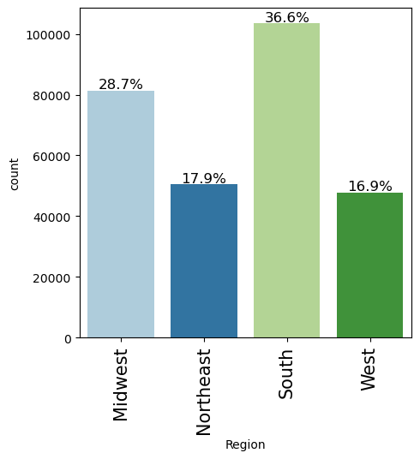
EXPLORATORY DATA ANALYSIS
DATA DICTIONARY CONT’
Observations
South has the most customer of 36.6% followed by Midwest of 28.7%

Slide 8
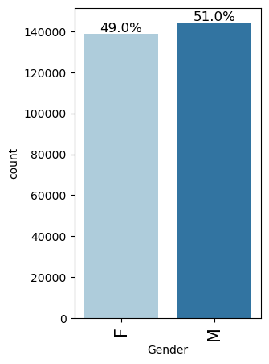
5. EXPLORATORY DATA ANALYSIS
EXPLORATORY DATA ANALYSIS CONT’
Observation
There are more male customers of 51% than female customer.

Slide 9
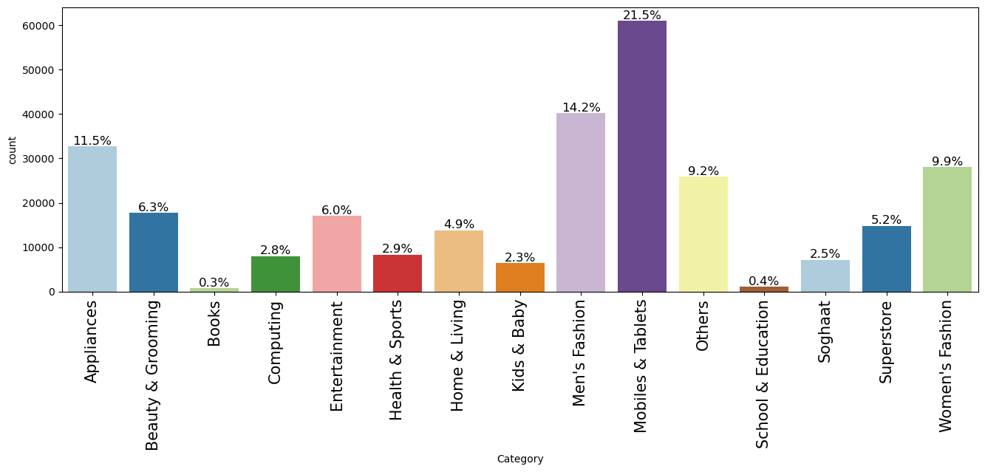
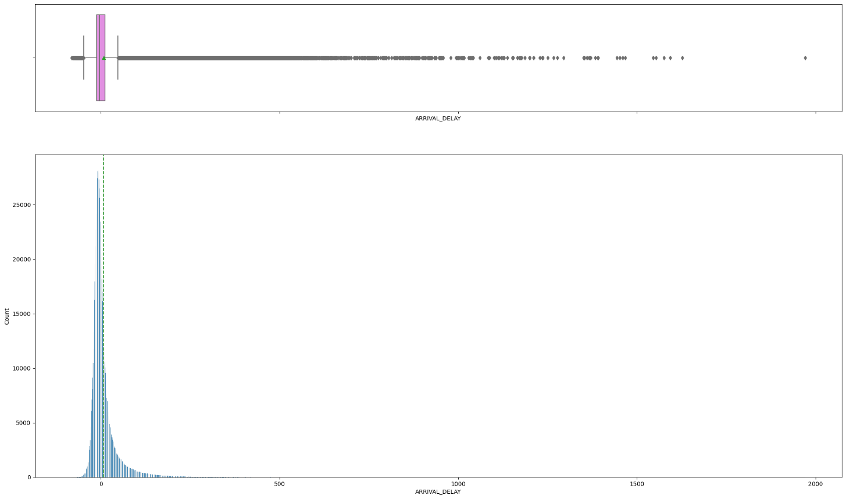
Exploratory Data Analysis –
EXPLORATORY DATA ANALYSIS CONT’
ARRIVALY
Mobiles and Tablets were the most sold items of 21.5% followed by Men’s fashion of 14.2%

Slide 10
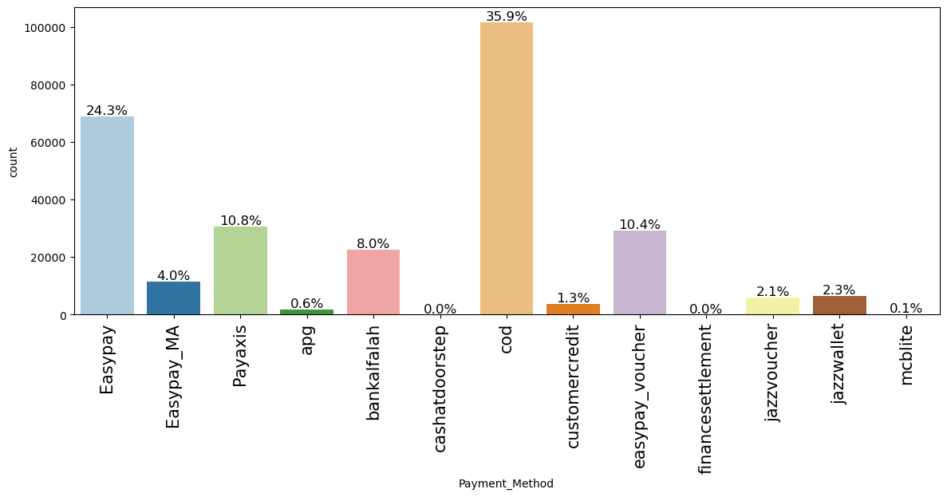
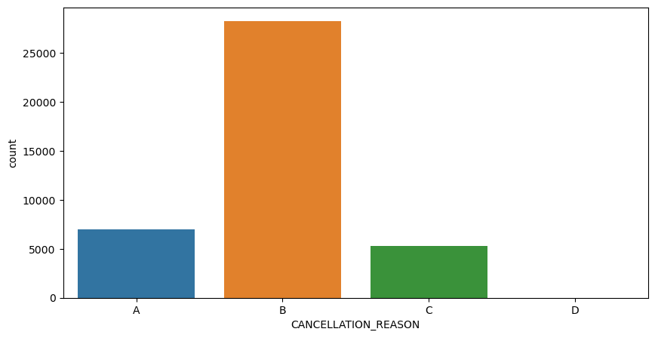
Exploratory Data Analysis –Distribution of cancellation reason
EXPLORATORY DATA ANALYSIS CONT’
* Cash On Delivery (cod) is the most used form of payment with about 35.9% followed by Easypay of 24.3%
A - Airline/Carrier; B - Weather; C - National Air System; D - Security
The distribution of the income is highly skewed to t

Slide 11
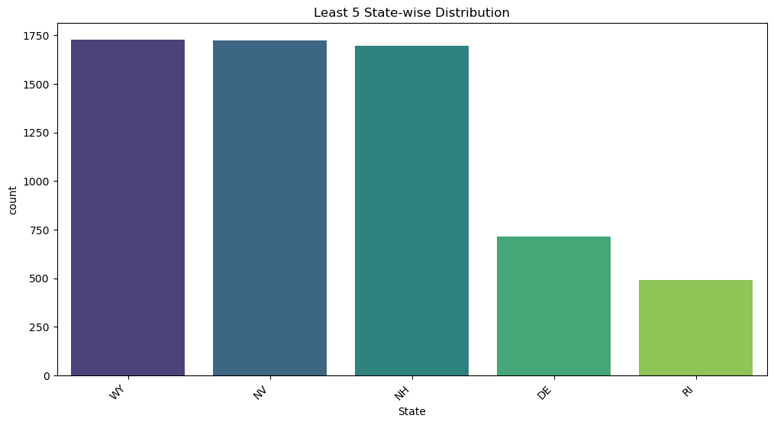
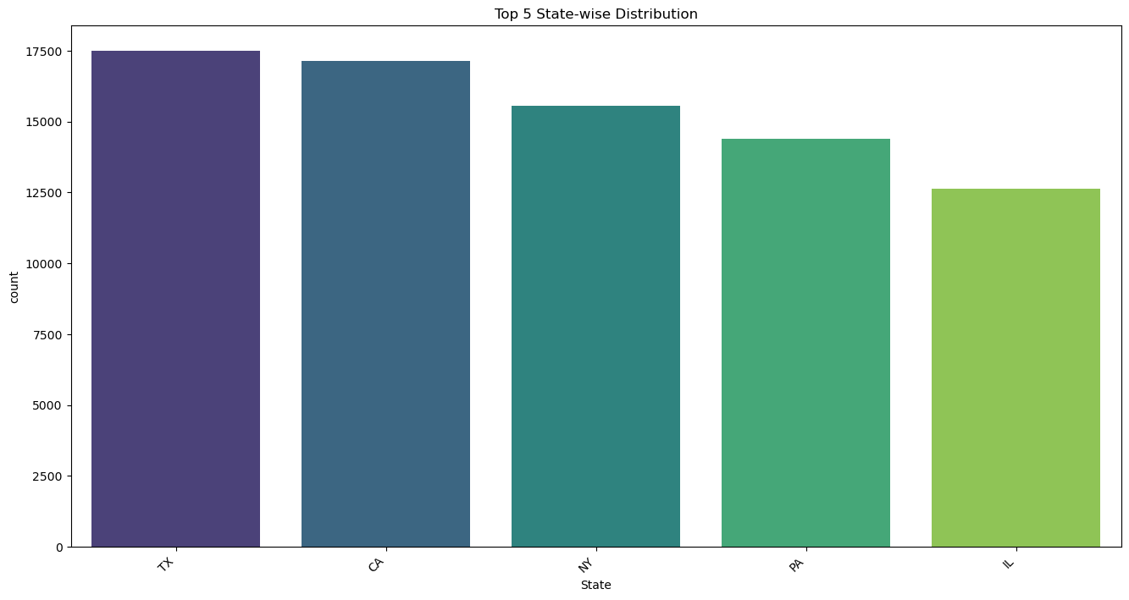
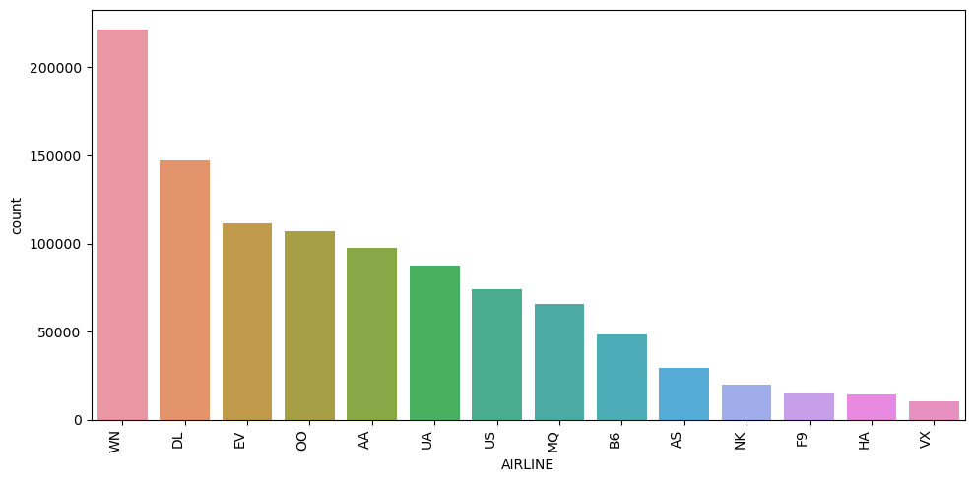
Exploratory Data Analysis
EXPLORATORY DATA ANALYTSIS CONT’
Rhode Island (RI) has the least distribution in terms of customer followed by Delaware(DE) while Texa has the highest distribution of customers followed by California.

Slide 12
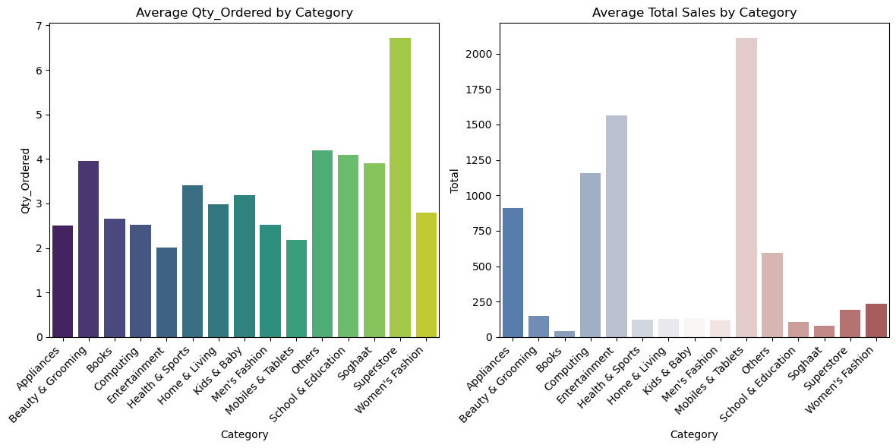
Exploratory Data Analysis
c [ ]:
EXPLORATORY DATA ANALYSIS CONT’
Superstore has the average quantity ordered by category but in terms of average total sales mobile and Tablets sold the most.

Slide 13
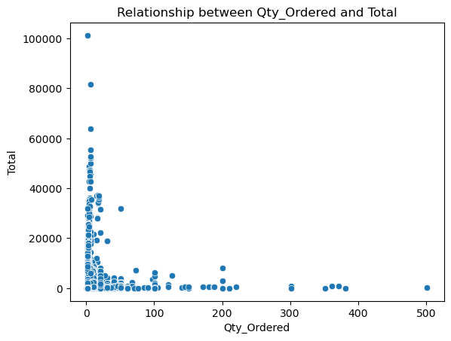
EXPLORATORY DATA ANALYSIS CONT’
:
The scatter plot indicated the least quantity ordered(1-20) had the most total sales compared with those with high number of quantity ordered.

Slide 14
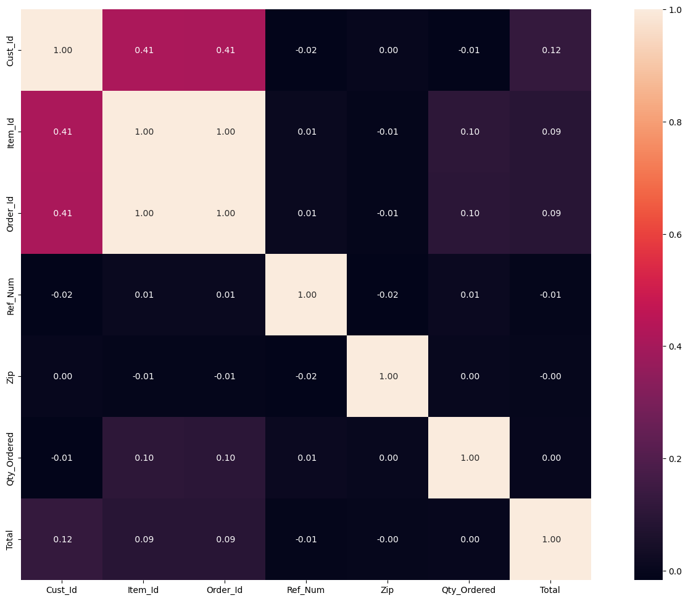
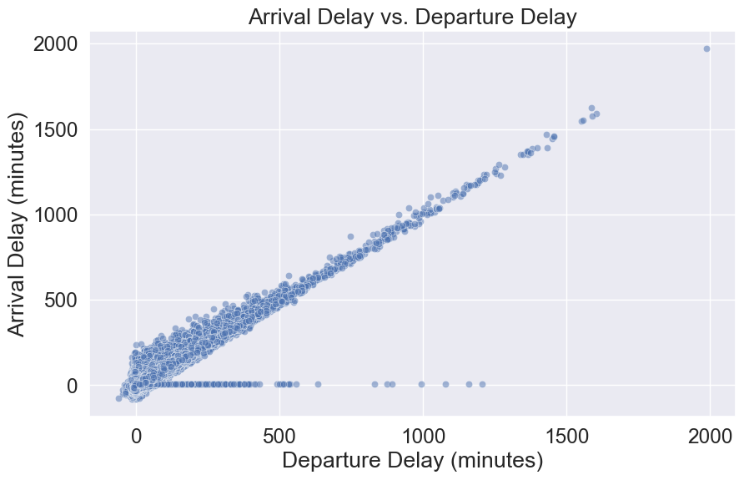
Exploratory Data Analysis – BIVARIATE
EXPLORATORY DATA ANALYSIS CONT’
It shows that there is no correlation between the Qty-Ordered and Total sales

Slide 15
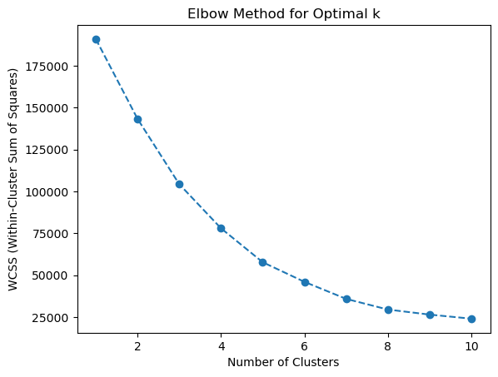
MACHINE LEARNING (DATA PREPROCESSING)
Observation
The graph slope slows at point 3 which is therefore considered a good estimate for the optimal number of clusters

Slide 16
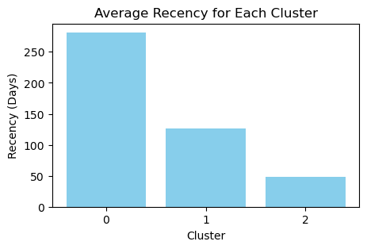
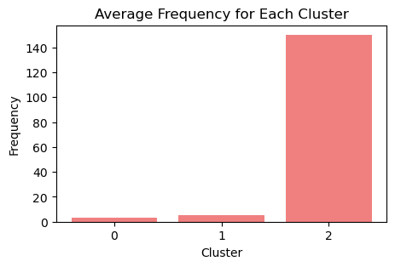
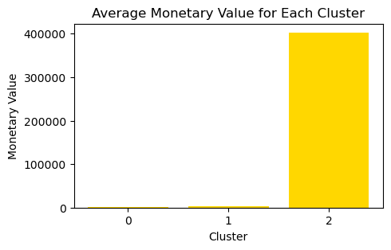
L
CUSTOMER SEGMENTATION USING RFM
Looking at the RFM for each cluster it is observed that cluster 2 is the loyal customer with recent visit more frequency and generated more money for the corporation followed by cluster 1 and cluster 0 being the least.

Slide 17
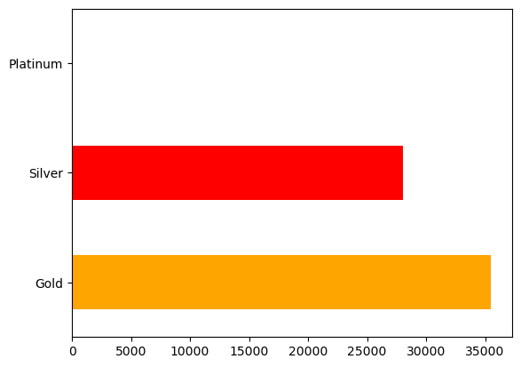
MODEL EVALUATION SUMMARY
CUSTOMER GROUPING
Grouping customer to Gold, silver and platinum it is observed that though the customer grouped as platinum are few, but it generated more in terms of monetary value.
Gold 35517 Silver 28036 Platinum 93

Slide 18
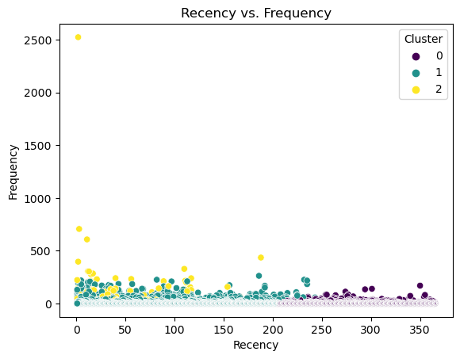
ANALYZING THE PLOT OF RFM
Confusion Matrix:
Cluster 2 had the most frequency value and visited more followed by cluster 1

Slide 19
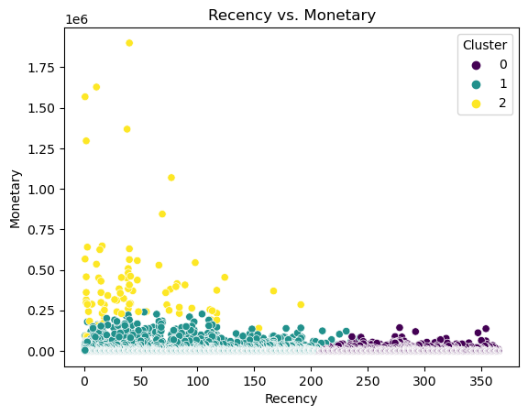
MODEL EVALUATION SUMMARY (CONT’)
ANALYZING THE PLOT OF RFM CONT’
In terms of monetary value cluster 2 is far the highest and most recent followed by cluster 1

Slide 20
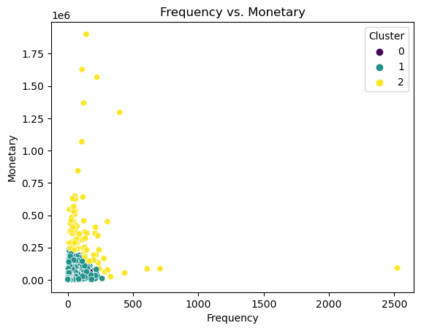
ANALYZING THE PLOT OF RFM CONT,
●
Cluster 2 again shows it is the targeted customer having shown the highest in terms of monetary value and with the most visit. Cluster 0 visited long time with frequency above 2500

Slide 21
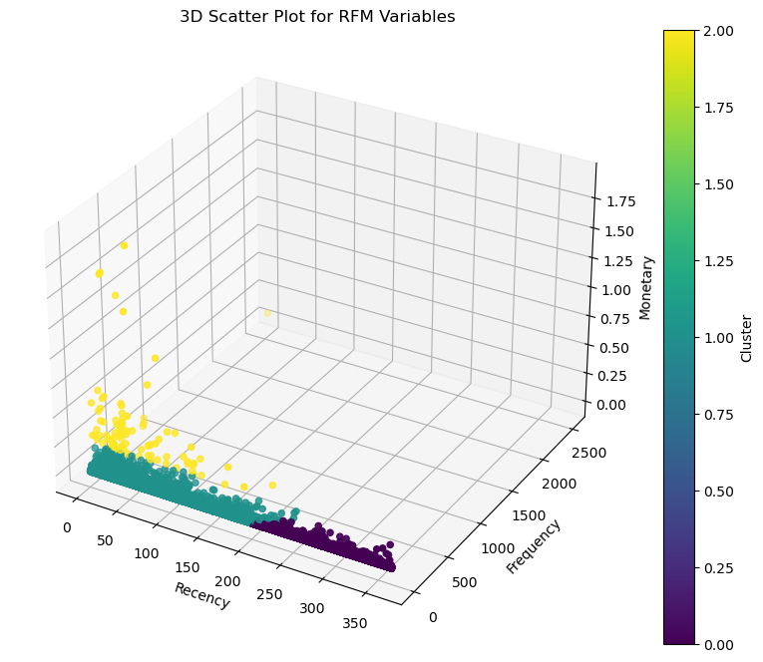
8. KEY INSIGHT AND RECOMMENDATIONS
ANALYZING THE PLOT OF RFM CONT’
Looking the the plot from the 3D point of view it is very obvious that cluster 2 had the most value in terms of monetary value, with the most frequency and recent visit.

Slide 22
KEY INSIGHTS : CLUSTERING AVERAGE
Cluster 0 (Silver)
Recency: 282 days
Frequency: 3 times
Monetary: $1982.62
Cluster 1 (Gold)
Recency: 126 days
Frequency: 5 times
Monetary: $3911.09
Cluster 2 (Platinum)
Recency: 49 days
Frequency: 149 times
Monetary: $393,085.79
Cluster 2 with the least customer spend the most in terms of monetary value and they are the loyal customers.

Slide 23
CONCLUSION
This RFM customer segmentation analysis helps business allocate resources more effectively by provides a roadmap for strategic decision-making, enabling organizations to tailor marketing efforts, improve customer experiences, and maximize the value of each segment. By implementing targeted strategies for Silver, Gold, and Platinum customers, and helps to foster customer loyalty, drive revenue growth, and position your brand as a leader in the market.

Slide 24
RECOMMENDATION
Based on the key insights, we propose the following strategies for business growth:
1. Regional Targeting:
Given the regional distribution, focus marketing efforts on the South and Midwest regions, where a significant customer base exists.The model identify these region where they have the most loyal customer Tailor promotions and campaigns to resonate with the preferences of customers in these regions.
2.Payment Method Optimization:Recognize the dominance of "cod" transactions and EasyPay. Consider incentivizing the use of other payment methods to diversify and streamline the payment process for both the business and customers.

Slide 25
RECOMMENDATION ON EACH CLUSTER
Based on the average of each cluster, here key insight and recommendations for each segment:
Silver Segment (Cluster 2):
Recency:
Customers in this segment have a high recency score (281 days), indicating that they haven't visited the platform recently. It's recommended to implement targeted re-engagement strategies such as personalized promotions, discounts, or reminders to encourage them to return and make a purchase. With a higher recency compared to the other segments, consider targeted promotions or loyalty programs to re-engage this group.

Slide 26
RECOMMENDATION ON SILVER SEGMENT (CLUSTER 2) CONT
Frequency:
The frequency is relatively low (2.2times), suggesting that they make occasional purchases. Consider offering loyalty programs, exclusive deals, or product recommendations based on their past purchases to increase their engagement and encourage more frequent transactions. Craft compelling campaigns to convert occasional customers into regular ones. Highlighting the potential benefits and value propositions can be effective.
Monetary:
The monetary value is moderate ($1,972), so efforts can be made to upsell or cross-sell to increase the average order value. Special promotions or bundled deals might be effective in boosting their spending.

Slide 27
RECOMMENDATION ON GOLD SEGMENT (CLUSTER 1)CONT’
Recency:
Customers in this segment have a moderate recency score (126 days), indicating recent visits. Ensure to maintain their engagement by providing personalized recommendations, exclusive offers, or early access to new products.

Slide 28
RECOMMENDATION ON GOLD SEGMENT (CLUSTER 1) CONT
Frequency:
The frequency is high (3.4 times), suggesting they make frequent purchases. Leverage this by introducing loyalty programs, referral bonuses, or special discounts for repeat purchases to foster customer loyalty. Focus on maintaining the loyalty of this segment through personalized offers and exclusive deals, given their moderate recency but higher frequency and monetary value.
Monetary:
The monetary value is high ($3,753), implying they spent a significant amount. Capitalize on this by offering premium products, VIP access, or personalized services to enhance their shopping experience.

Slide 29
RECOMMENDATION ON PLATINUM SEGMENT (CLUSTER 3)
Recency:
Customers in this segment have a very low recency score (60 days), indicating they have visited the platform recently. Implement targeted campaigns, personalized promotions, or exclusive offers to engage them.

Slide 30
RECOMMENDATION ON PLATINUM SEGMENT (CLUSTER 2) CONT’
Frequency:
The frequency is extremely high (104.5 times), indicating they made frequent purchases in the past. Investigate reasons for the drop in frequency and tailor marketing efforts to reignite their interest, such as personalized recommendations or special incentives for returning customers. Build a close relationship with these top-tier customers through exclusive communications, seeking feedback, and involving them in brand initiatives.
Monetary:
The monetary value is exceptionally high ($277,608), suggesting they have a significant lifetime value. Develop personalized loyalty programs, exclusive perks, or premium services to maintain their high spending and enhance their overall satisfaction. Prioritize VIP treatment for this high-value segment. Consider premium services, early access, or personalized experiences to enhance their loyalty further.

Slide 31
4. Enhanced Customer Communication:
Utilize customer segments to craft targeted and personalized communication strategies. Tailor marketing messages, promotions, and product recommendations based on the preferences and behaviors of each segment.

Slide 32
5. Continuous Monitoring and Adaptation:
Regularly analyze customer segments and adapt strategies based on evolving trends. Stay agile to respond to changes in customer behavior and market dynamics.
By implementing these recommendations, our company can optimize customer engagement, drive sales, and maintain a competitive edge in the e-commerce industry.

Slide 33

Thank you
16
Proprietary content. © Great Learning. All Rights Reserved. Unauthorized use or distribution prohibited.

